Slide 1

Winter Mode v1.2 - Remote Activation for Electric Cars Project
Scrum Project Presentation
Information Systems and Business Analytics, Park University
CIS604DLBF2P2023 Project Management for Information Technology
Professor Dr. Sixtus Ekwo
Unit 8: Assignment - Dec 10, 2023
Avinash Bunga

Slide 2

Executive Summary of Winter Mode v1.2 Project
Project Overview: Enhancing the Electric Car Experience with Winter Mode v1.2
Demand: Addressing user demand for intuitive, remote winter car preparation
Objective: Seamless integration of 'Winter Mode' in the existing mobile app
Methodology: Scrum for flexible, iterative development
Duration: Deployment over a 50-week sprint schedule
End Goal: Superior user experience and strengthened brand loyalty

Slide 3

Project Scope and Objectives
Scope Definition: Integration of a 'Winter Mode' for remote car functionality.
User Centricity: Focused on user convenience and accessibility.
Design Excellence: Prototyping a user-friendly interface for app enhancement.
Quality Assurance: Comprehensive testing for unmatched reliability.
Market Alignment: Promotional activities to maximize user adoption.
Strategic Deployment: Seamless rollout across app stores for easy access.
Feedback Incorporation: Leveraging user input for continuous improvement.

Slide 4

Methodology
Agile Framework: Adopting Scrum for flexibility and iterative progress.
Collaborative Sprints: Structured development sprints for incremental delivery.
Continuous Integration: Seamless code integration and testing for quality assurance.
Stakeholder Engagement: Regular check-ins to align with stakeholder expectations.
Feedback Loops: Incorporating feedback for continuous product enhancement.
Risk Management: Proactive identification and mitigation of potential risks.
Deployment Strategy: Methodical release plan for maximum stability and user satisfaction.

Slide 5
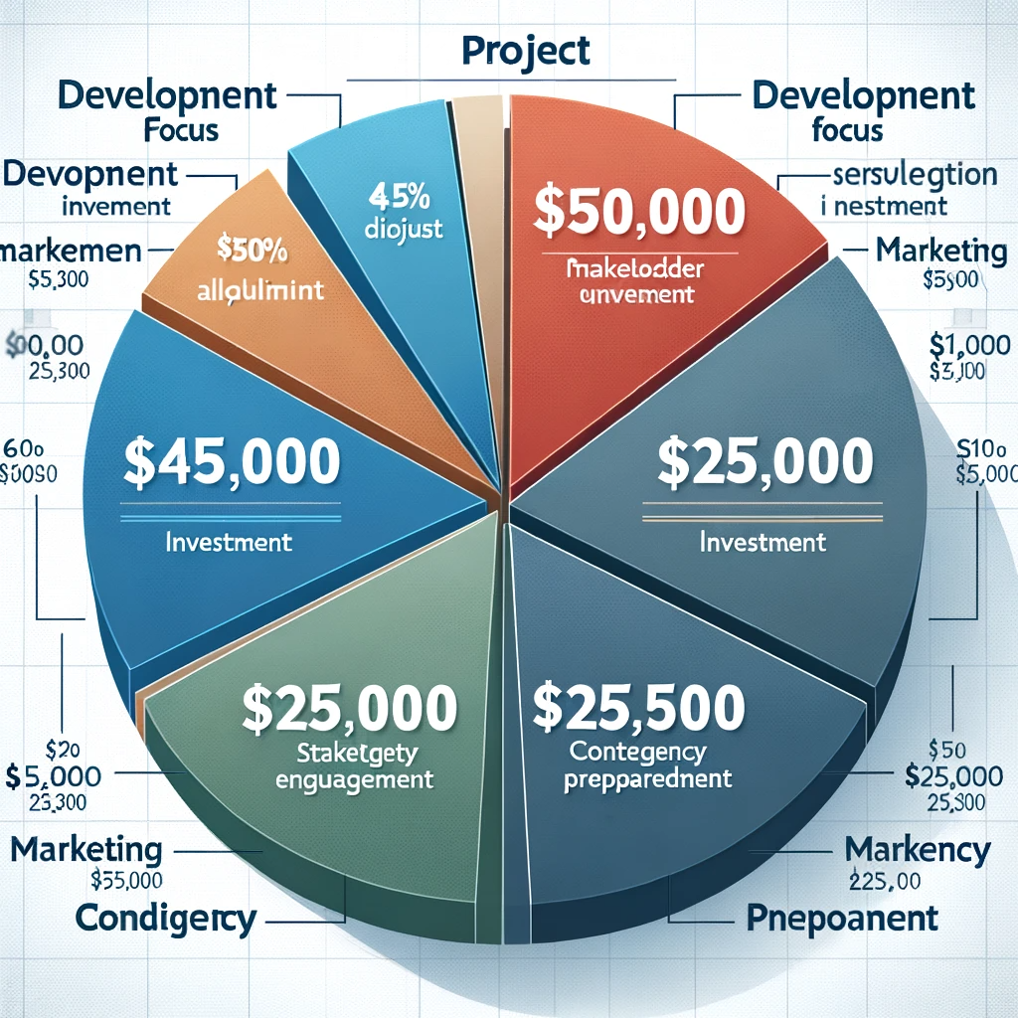
Project Budget Overview
Total Allocation: Strategically budgeted at $250,000 for full project lifecycle.
Development Focus: Major share of $150,000 dedicated to development and testing.
Marketing Investment: Allocated $50,000 for robust market penetration and adoption.
Stakeholder Engagement: $25,000 to ensure thorough communication and training.
Contingency Preparedness: Reserved $25,000 for unforeseen project exigencies.

Slide 6
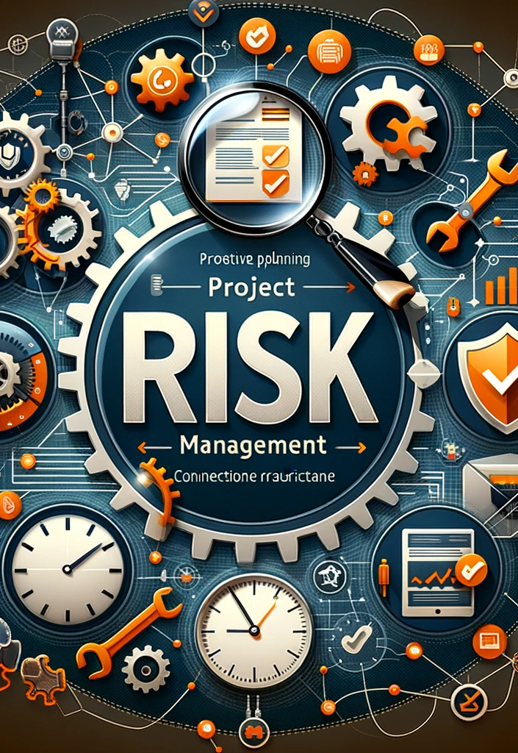
Project Risk Management
Proactive Planning: Risk identification and proactive mitigation are at the forefront.
Technical Challenges: Dedicated strategies to address integration and technical risks.
Connectivity Assurance: Contingencies for stable app performance across network conditions.
Timeline Adherence: Buffer periods and agile management to prevent and address delays.
Security Protocols: Rigorous security measures to safeguard user data integrity.

Slide 7

Characteristics of Effective Project Managers
Strategic Vision: Ability to align project goals with organizational objectives.
Agile Leadership: Adapts swiftly to changes, maintaining project momentum.
Exceptional Communication: Ensures clarity and alignment among team members and stakeholders.
Risk Management Acumen: Proactively identifies and mitigates project risks.
Decision-Making Skills: Makes informed decisions swiftly to navigate project challenges.
Team Empowerment: Inspires and motivates the team, fostering a collaborative environment.
Results-Oriented: Focused on delivering high-quality outcomes within stipulated timelines.

Slide 8

Major Milestones and Timeline
Project Kickoff: Commencement of the project with team alignment and scope definition.
Design Finalization: Completion of the user interface design and prototyping phase.
Development Sprints: Sequential development phases focusing on iterative feature releases.
Quality Assurance: Comprehensive testing to ensure functionality and user satisfaction.
Marketing Campaign: Strategic promotion phase for market awareness and user adoption.
App Store Deployment: Finalizing and launching the enhanced app on major platforms.
Project Closure: Concluding with a review, feedback integration, and future planning.

Slide 9

Conclusion
Project Impact: Significant enhancement in user experience with the 'Winter Mode' feature.
Achievement of Goals: Successfully met project objectives within the designated timeline.
Team Collaboration: Outstanding teamwork and agile methodology for project success.
Future Prospects: Lays the foundation for further innovations in app functionality.
Stakeholder Satisfaction: High stakeholder satisfaction, aligning with business goals.
Learning and Growth: Project insights contribute to ongoing organizational development.
Commitment to Excellence: Our dedication to delivering cutting-edge technology solutions.

Slide 10
References
Dumont, P. R., Gibson Jr., G. E., & Fish, J. R. (1997). Scope Management Using Project Definition Rating Index. Journal of Management in Engineering, 13(5), 54. https://doi.org/10.1061/(ASCE)0742-597X(1997)13:5(54)
Kateřina Bočková, & Slávka Čepelová. (2023). Exploring Personality Traits in Elite Sport Players and Associate with a Good Project Managers. Emerging Science Journal, 7(4), 1315–1331. https://doi.org/10.28991/ESJ-2023-07-04-019
Laslo, Z., & Gurevich, G. (2014). Enhancing Project on Time Within Budget Performance by Implementing Proper Control Routines. Management (1820-0222), 19(72), 53–69. https://doi.org/10.7595/management.fon.2014.0019
Lucy Robinson. (2023). The Matched Education Dataset project: Methodology and lessons learned. International Journal of Population Data Science, 8(2). https://doi.org/10.23889/ijpds.v8i2.2233
LIARGOVAS, P. (2023). Executive Summary. Greek Economic Outlook, 50, 3– 5.https://search.ebscohost.com/login.aspx?direct=true&AuthType=sso&db=bsu&AN =163176437&Custid=083-900
Lucy Robinson. (2023). The Matched Education Dataset project: Methodology and lessons learned. International Journal of Population Data Science, 8(2). https://doi.org/10.23889/ijpds.v8i2.2233
McAlister, D. T. (2006). The Project Management Plan: Improving Team Process and Performance. Marketing Education Review, 16(1), 97–103. https://doi.org/10.1080/10528008.2006.11488946
Tavares, B. G., da Silva, C. E. S., & de Souza, A. D. (2019). Risk management analysis in Scrum software projects.International Transactions in Operational Research, 26(5), 1884–1905. https://doi.org/10.1111/itor.12401

Slide 11

Thank You for Your Engagement
"Special thanks to our Professor, Dr. Sixtus Ekwo for guiding our learning journey and paving the way for our progress."
"A heartfelt thank you to my classmates for the enriching discussions and shared learning experiences."

